Slide 1
Internet of Things(Project)
Smart Home Automation Using Raspberry Pi

Slide 2
Internet of Things(Project)
Smart Home Automation Using Raspberry Pi
^{Components Used}
^{Circuit Board}
^{Sensors}
^{Actuators}

Slide 3
Internet of Things(Project)
Smart Home Automation Using Raspberry Pi
^{Components Used}
^{Circuit Board}
^{Sensors}
^{Actuators}

Slide 4
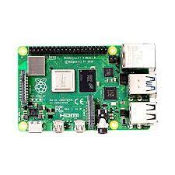
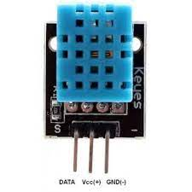
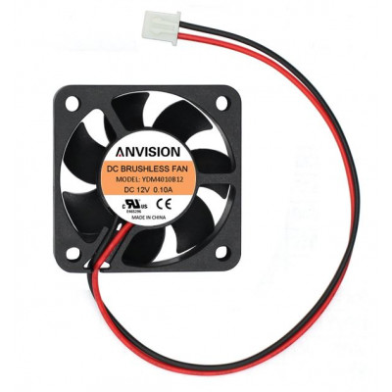

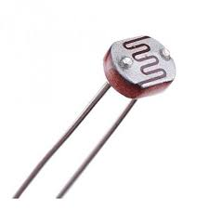
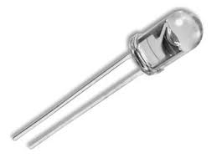
Internet of Things(Project)
Smart Home Automation Using Raspberry Pi
^{Components Used}
^{Circuit Board}
^{Sensors}
^{Actuators}

Slide 5
^{Components Used}
^{Circuit Board}
^{Sensors}
^{Actuators}
^{Circuit Diagram}

Slide 6
^{Components Used}
^{Circuit Board}
^{Sensors}
^{Actuators}
^{Circuit Diagram}

Slide 7
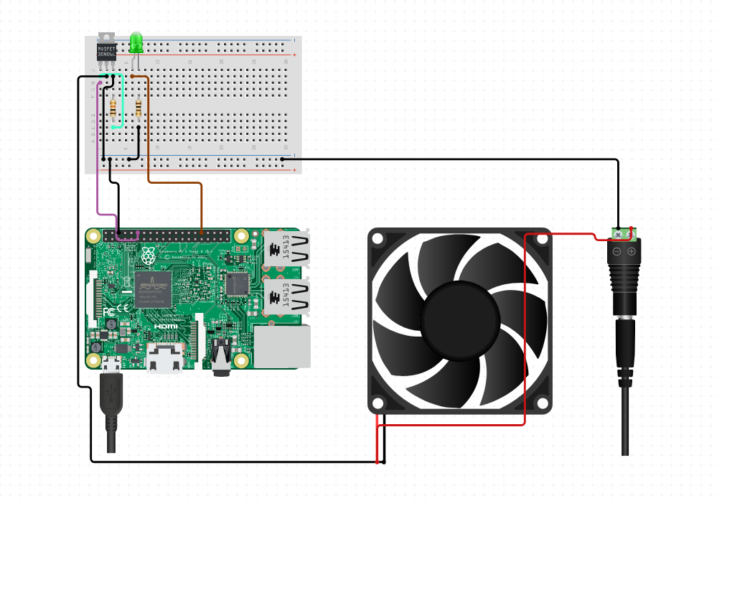
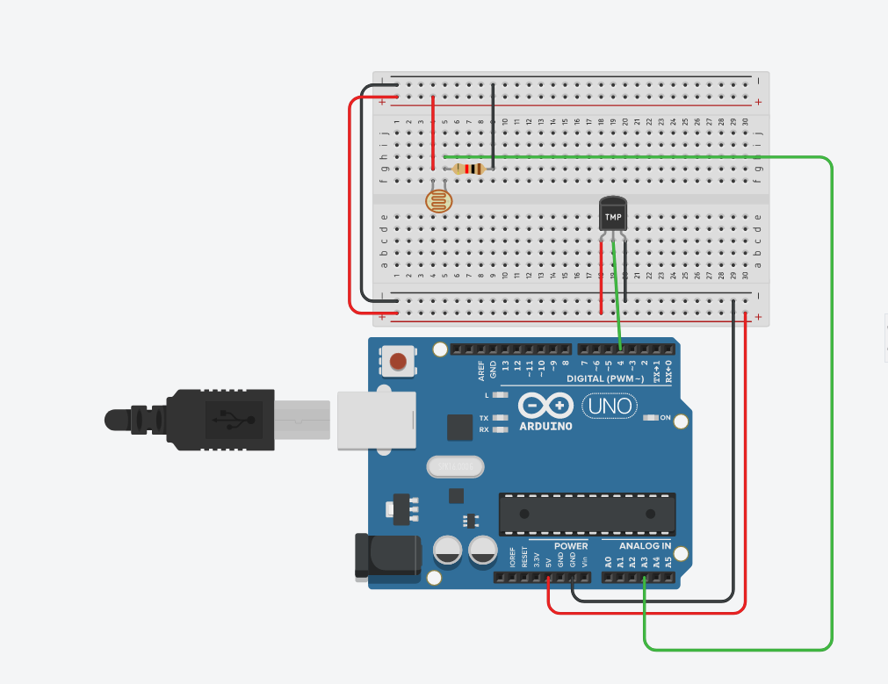
^{Circuit Diagram}

Slide 8
^{Circuit Diagram}
^{Working Images}

Slide 9
^{Circuit Diagram}
^{Working Images}

Slide 10
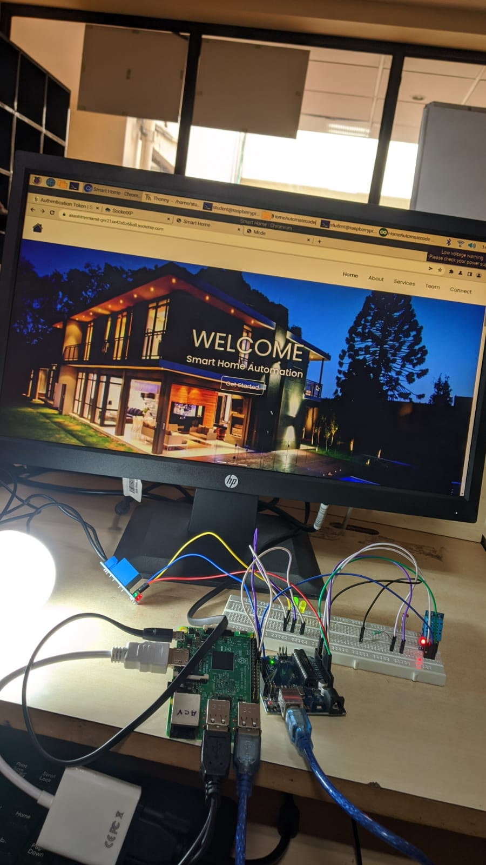
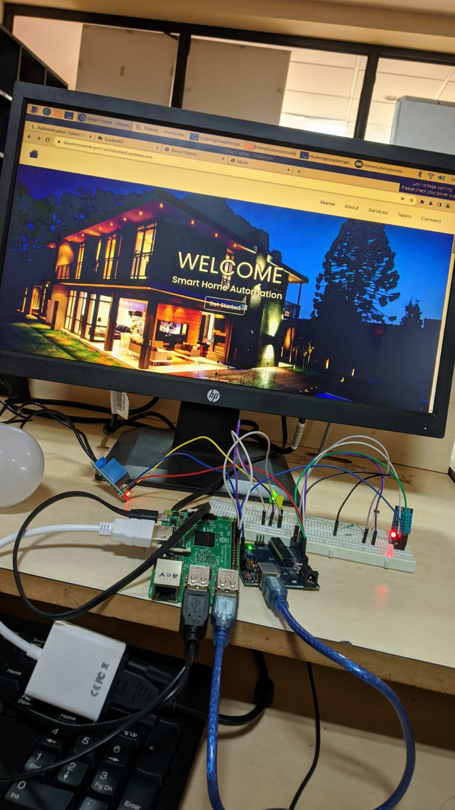
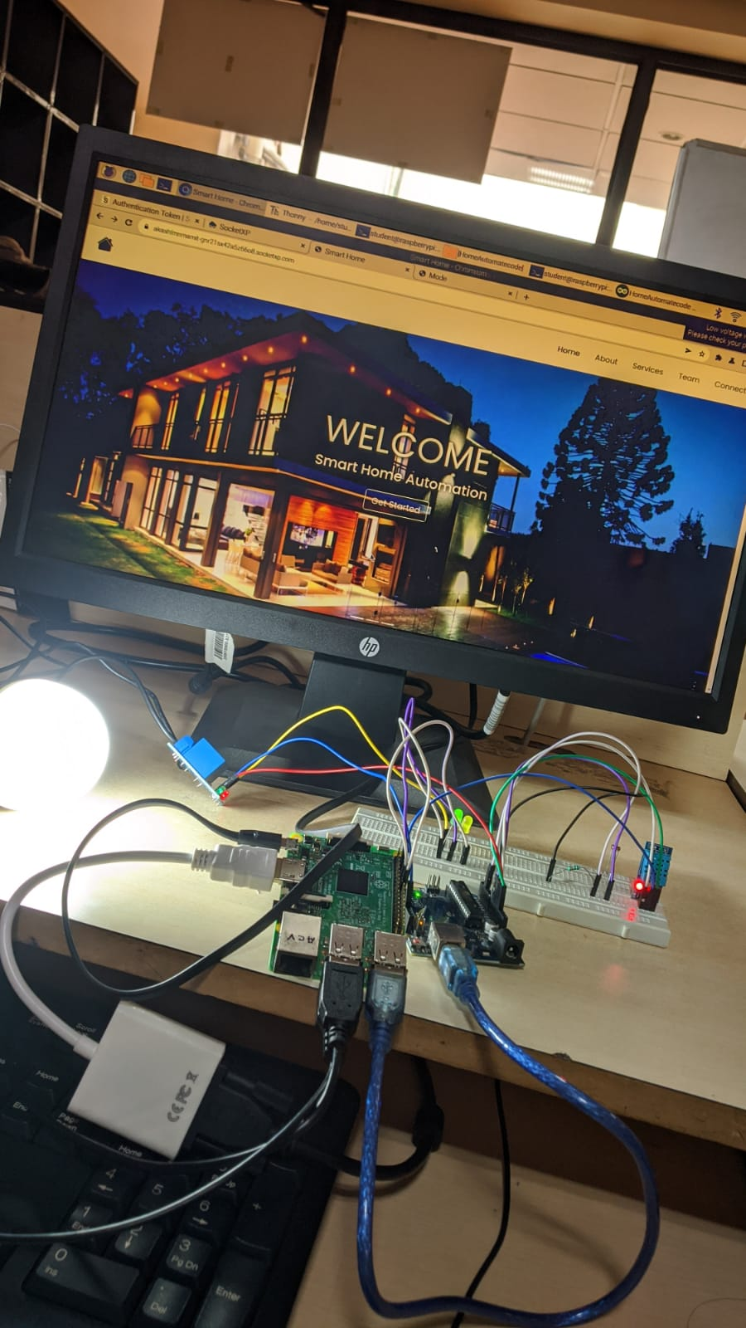
^{Working Images}

Slide 11
^{Working Images}
^{Demonstration}

Slide 12
^{Working Images}
^{Demonstration}

Slide 13
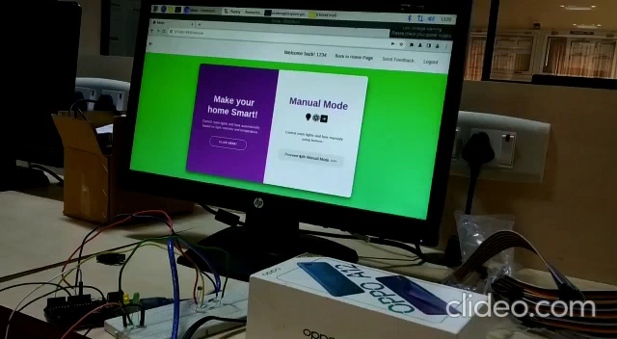
^{Demonstration}

Slide 14
^{Demonstration}
Thank you
^{By:- Akash L M, Abdeali}

Slide 15
^{Demonstration}
Thank you
^{By:- Akash L M, Abdeali}

